Slide 1
Chapter 2: Introduction to the Relational Model

Slide 2
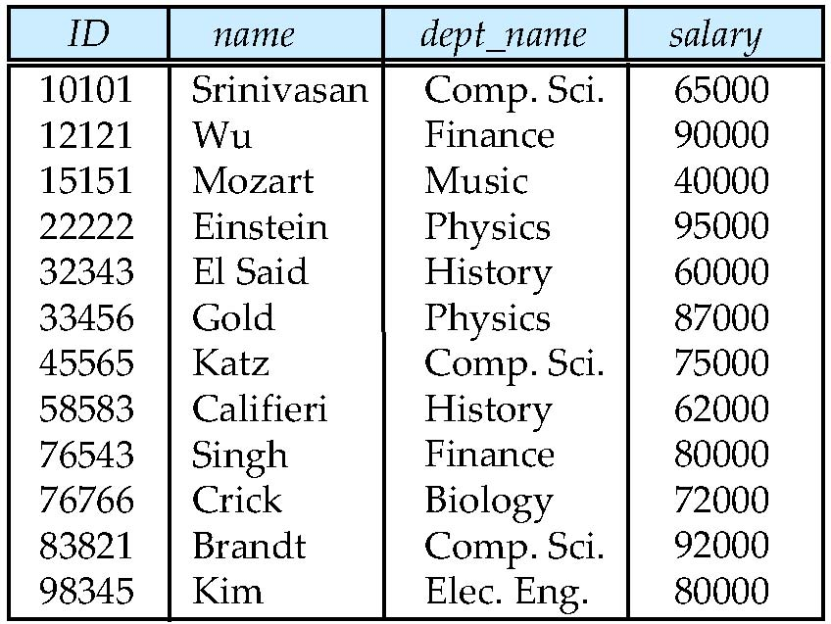
Example of a Relation
attributes
(or columns)
tuples
(or rows)
Instructor

Slide 3
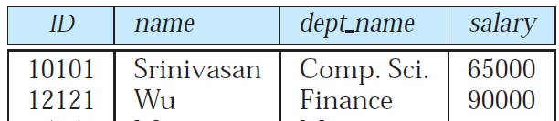
Attribute Types
Each attribute of a relation has a name
The set of allowed values for each attribute is called the domain of the attribute
Attribute values are (normally) required to be atomic; that is, indivisible
E.g. the value of an attribute can be a phone number, but cannot be a set of phone numbers
The special value null is a member of every domain
The null value causes complications in the definition of many operations
We shall ignore the effect of null values in our main presentation and consider their effect later

Slide 4
Relation Schema and Instance
A₁, A₂, …, A_{n} are attributes
R = (A₁, A₂, …, A_{n} ) is a relation schema
Example:
instructor = (ID, name, dept_name, salary)
Formally, given sets D₁, D₂, …. D_{n} a relation r is a subset of D₁ x D₂ x … x D_{n} Thus, a relation is a set of n-tuples (a₁, a₂, …, a_{n}) where each a_{i} ∈ D_{i}
The current values (relation instance) of a relation are specified by a table
An element t of r is a tuple, represented by a row in a table

Slide 5
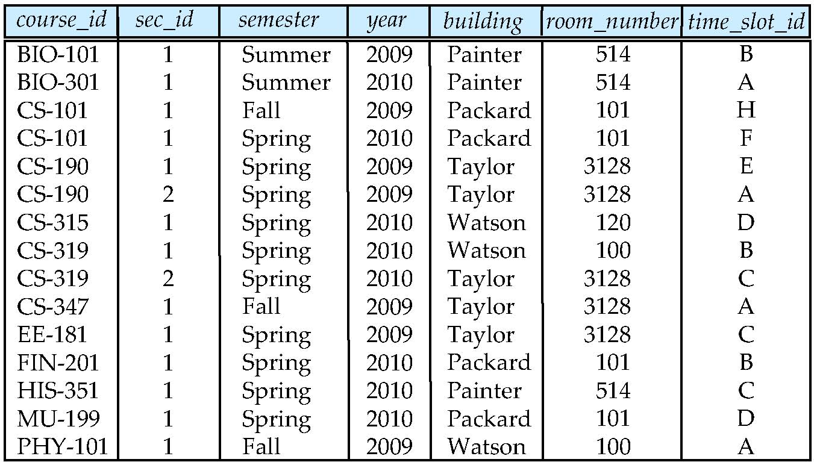
Relation Schema and Instance
Relation Schema
section(course_id, sec_id, semester, year, building, room_number, time_slot_id)
Relation Instance
Schema
Instance

Slide 6
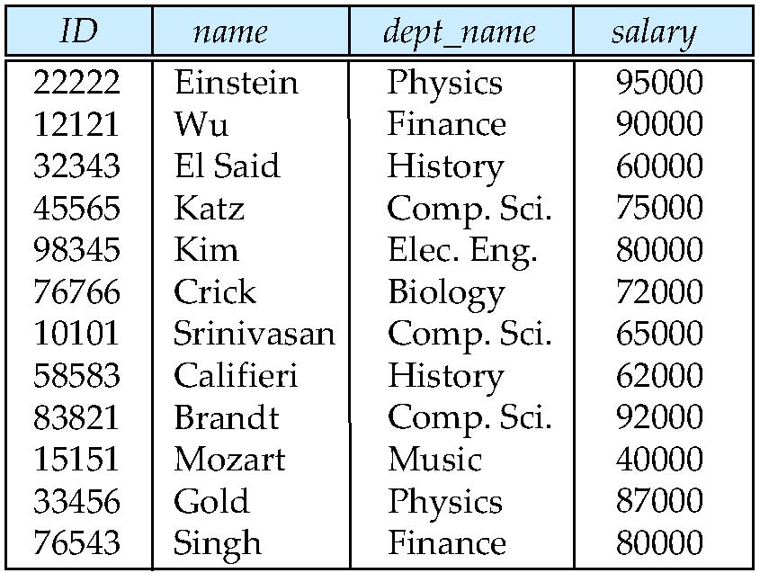
Relations are Unordered
Order of tuples is irrelevant (tuples may be stored in an arbitrary order)
Example: instructor relation with unordered tuples

Slide 7
Database
A database consists of multiple relations
Information about an enterprise is broken up into parts
instructor (ID, name, dept_name, salary) stores information about instructor
student (ID, name, dept_name,tot_cred) stores information about student
advisor(s_id,i_id) stores information about which instructor instruct which student
department, course, section, teaches, takes…..

Slide 8
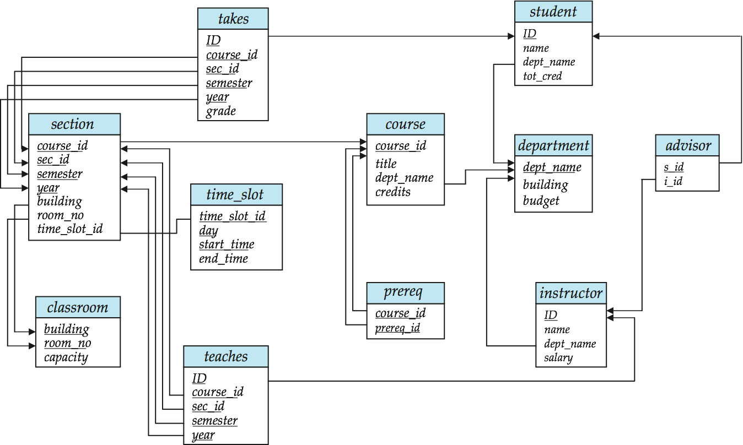
Schema Diagram for University Database
Sample Data in P1277 A.3

Slide 9
Database
Bad design: univ (instructor -ID, name, dept_name, salary, student_Id, ..) results in
repetition of information
e.g., two students have the same instructor
the need for null values
e.g., represent an student with no advisor)
Normalization theory (Chapter 7) deals with how to design “good” relational schemas

Slide 10
Keys
Let K ⊆ R
K is a superkey of R if values for K are sufficient to identify a unique tuple of each possible relation r(R)
by “possible r ” we mean a relation r that could exist in the enterprise we are modeling.
Example: {ID} and {ID, name} are both superkeys of instructor, but {name} is not a superkey of instructor since several instructors might have the same name.

Slide 11
Keys (Cont.)
K is a candidate key if K is minimal Example: {ID} is a candidate key for instructor, since it is a superkey and no subset of it is a superkey. {ID, name} is not a candidate key for instructor.
Primary key: a candidate key chosen as the principal means of identifying tuples within a relation
E.g. {ID} and {name, dept_name} are both candidate keys for instructor.
Should choose an attribute whose value never, or very rarely, changes.
E.g. email address is unique, but may change

Slide 12
Primary key
When a table is created, we can specify a set of attributes as the primary key of the table…
… in order to prevent two tuples from having identical values on all these attributes.
Different primary keys have different effects.
See next.

Slide 13
Primary key example
Assume that we create a table for the library with the schema: BORROW(student-id, book-id, out-date, return-date)
If we specify the primary key as student-id, can the following two tuples appear in BORROW together?
(1, b200, jan 1, jan 3) (1, b201, jan 1, jan 3)
NO, because no two tuples can have the same student-id.
Effect?
Every student is allowed to borrow from the library once!

Slide 14
Primary key example (cont.)
BORROW(student-id, book-id, out-date, return-date)
If the primary key is book-id, can the following two tuples appear together?
(1, b200, jan 1, jan 3) (2, b200, jan 4, jan 5)
NO.
Effect?
No book can ever be borrowed again!

Slide 15
Primary key example (cont.)
BORROW(student-id, book-id, out-date, return-date)
If the primary key is out-date, can the following two tuples appear together?
(1, b200, jan 1, jan 2) (2, b201, jan 1, jan 3)
NO.
Effect?
Every day the library lends at most 1 book.

Slide 16
Primary key example (cont.)
BORROW(student-id, book-id, out-date, return-date)
If the primary key is {student-id, book-id}, can the following two tuples appear together?
(1, b200, jan 1, jan 2) (1, b200, jan 3, jan 4)
NO.
Effect?
No student can borrow the same book twice.

Slide 17
Primary key example (cont.)
BORROW(student-id, book-id, out-date, return-date)
If the primary key is {student-id, book-id, out-date}, can the following two tuples appear together?
(1, b200, jan 1, jan 1) (1, b200, jan 1, jan 4)
NO.
Effect?
No student can borrow the same book twice on the same day.

Slide 18
Primary key example (cont.)
BORROW(student-id, book-id, out-date, return-date)
If the primary key is {student-id, book-id, out-date}, can the following two tuples appear together?
(1, b200, jan 1, jan 1) (1, b200, jan 2, jan 4)
Yes, because the two tuples differ in ‘out-date’.

Slide 19
Foreign Keys
A relation schema may have an attribute that corresponds to the primary key of another relation. The attribute is called a foreign key.
E.g. s_id and i_id attributes of advisor are foreign keys to instructor and student respectively.
Only values occurring in the primary key attribute of the referenced relation may occur in the foreign key attribute of the referencing relation.

Slide 20
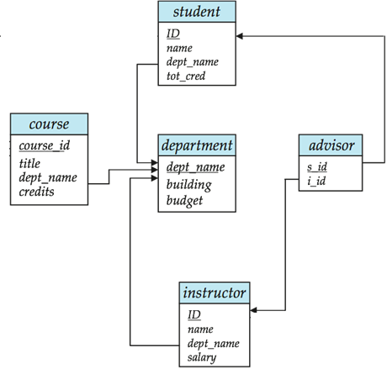
Foreign Keys
`

Slide 21
Schema Diagram for University Database

Slide 22
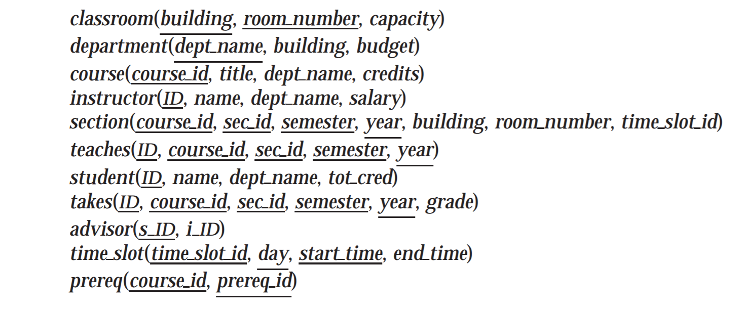
Schema of the university database

Slide 23
Relational Query Languages
Language in which user requests information from the database.
Categories of languages
Procedural
Non-procedural, or declarative
“Pure” languages:
Relational algebra
Tuple relational calculus
Domain relational calculus
The above 3 pure languages are equivalent in computing power

Slide 24
Relational Algebra
Procedural language
Six basic operators
select: σ
project: ∏
union: ∪
set difference: –
Cartesian product: x
rename: ρ
The operators take one or two relations as inputs and produce a new relation as a result.

Slide 25
Select Operation
Notation: σ _{p}(r)
p is called the selection predicate
Defined as: σ_{p}(r) = {t | t ∈ r and p(t)}
Where p is a formula in propositional calculus consisting of terms connected by : ∧ (and), ∨ (or), ¬ (not) Each term is one of:
<attribute> op <attribute> or <constant>
where op is one of: =, ≠, >, ≥. <. ≤
Example of selection: σ _{dept_name=“Physics”}(instructor)

Slide 26
Select Operation – Example
Relation r
A
B
C
D
α
α
β
β
α
β
β
β
1
5
12
23
7
7
3
10
σ_{A=B ^ D > 5} (r)
A
B
C
D
α
β
α
β
1
23
7
10

Slide 27
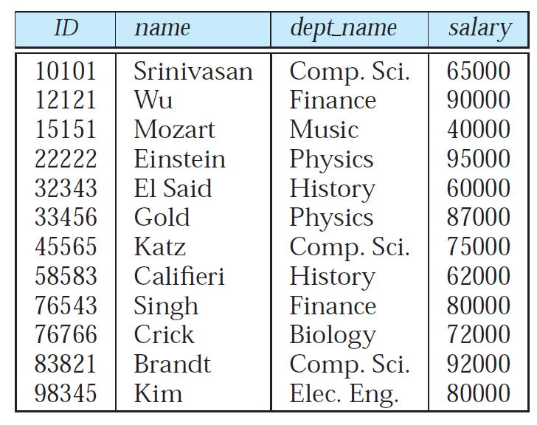
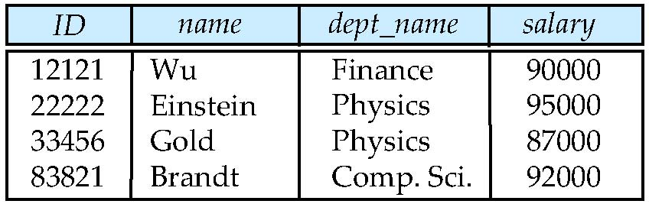
Select Operation – Example
The instructor relation.
Whose salary is greater than $85000?
σ_{salary>85000}(instructor)

Slide 28
Project Operation
Notation:
where A₁, A₂ are attribute names and r is a relation name.
The result is defined as the relation of k columns obtained by erasing the columns that are not listed
Duplicate rows removed from result, since relations are sets
Example: To eliminate the dept_name attribute of instructor ∏_{ID, name, salary} (instructor)

Slide 29
Project Operation – Example
Relation r:
∏_{A,C} (r)
A
B
C
α
α
β
β
10
20
30
40
1
1
1
2
A
C
A
C
α
α
β
β
1
1
1
2
α
β
β
1
1
2
=

Slide 30
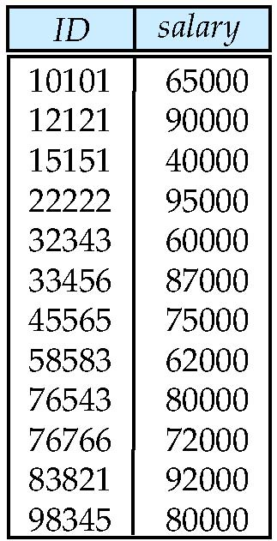
Project Operation – Example
The instructor relation.
We want a list of instructor IDs and salaries without listing the name and dept name values
∏_{ID,salary}(instructor )

Slide 31
Union Operation
Notation: r ∪ s
Defined as:
r ∪ s = {t | t ∈ r or t ∈ s}
For r ∪ s to be valid.
1. r, s must have the same arity (same number of attributes)
2. The attribute domains must be compatible (example: 2nd column of r deals with the same type of values as does the 2nd column of s)
Example: to find all courses taught in the Fall 2009 semester, or in the Spring 2010 semester, or in both ∏_{course_id} (σ _{semester=“Fall” Λ year=2009} (section)) ∪ ∏_{course_id} (σ _{semester=“Spring” Λ year=2010} (section))

Slide 32
Union Operation – Example
Relations r, s:
A
B
A
B
α
α
β
1
2
1
α
β
2
3
s
r
r ∪ s:
A
B
α
α
β
β
1
2
1
3

Slide 33
Set Difference Operation
Notation r – s
Defined as:
r – s = {t | t ∈ r and t ∉ s}
Set differences must be taken between compatible relations.
r and s must have the same arity
attribute domains of r and s must be compatible
Example: to find all courses taught in the Fall 2009 semester, but not in the Spring 2010 semester ∏_{course_id} (σ _{semester=“Fall” Λ year=2009} (section)) − ∏_{course_id} (σ _{semester=“Spring” Λ year=2010} (section))

Slide 34
Set Difference Operation – Example
Relations r, s:
A
B
A
B
α
α
β
1
2
1
α
β
2
3
s
r
r – s:
A
B
α
β
1
1

Slide 35
Rename Operation
Allows us to name, and therefore to refer to, the results of relational-algebra expressions.
Allows us to refer to a relation by more than one name.
Example:
ρ _{x} (E)
returns the expression E under the name X
If a relational-algebra expression E has arity n, then
returns the result of expression E under the name X, and with the attributes renamed to A₁ , A₂ , …., A_{n} .

Slide 36
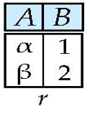
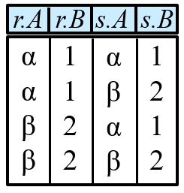
Renaming a Table
Allows us to refer to a relation, (say E) by more than one name.
ρ _{x} (E)
returns the expression E under the name X
Relations r
r x ρ _{s} (r)

Slide 37
Cartesian-Product Operation
Notation r x s
Defined as:
r x s = {t q | t ∈ r and q ∈ s}
Assume that attributes of r(R) and s(S) are disjoint. (That is, R ∩ S = ∅).
If attributes of r(R) and s(S) are not disjoint, then renaming must be used.

Slide 38
Cartesian-Product Operation – Example
Relations r, s:
A
B
C
D
E
α
β
1
2
α
β
β
γ
10
10
20
10
a
a
b
b
r
s
r x s:
A
B
C
D
E
α
α
α
α
β
β
β
β
1
1
1
1
2
2
2
2
α
β
β
γ
α
β
β
γ
10
10
20
10
10
10
20
10
a
a
b
b
a
a
b
b

Slide 39
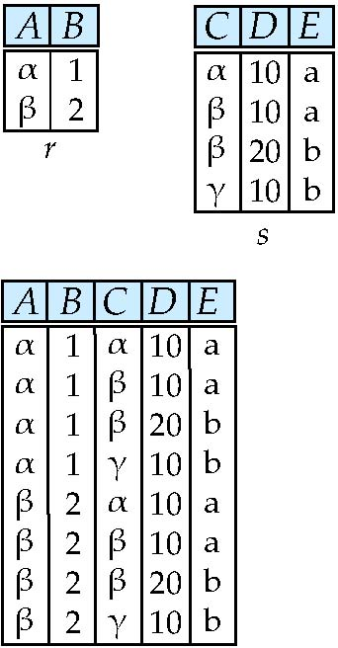
Cartesian-product – naming issue
B
Relations r, s:
r.B
s.B
r x s:

Slide 40
Set-Intersection Operation
Notation: r ∩ s
Defined as:
r ∩ s = { t | t ∈ r and t ∈ s }
Assume:
r, s have the same arity
attributes of r and s are compatible
Note: r ∩ s = r – (r – s)

Slide 41
Set-Intersection Operation – Example
Relation r, s:
r ∩ s
A B
A B
α
α
β
1
2
1
α
β
2
3
s
r
A B
α 2

Slide 42
Natural-Join Operation
Notation: r s
Let r and s be relations on schemas R and S respectively. Then, r s is a relation on schema R ∪ S obtained as follows:
Consider each pair of tuples t_{r} from r and t_{s} from s.
If t_{r} and t_{s} have the same value on each of the attributes in R ∩ S, add a tuple t to the result, where
t has the same value as t_{r} on r
t has the same value as t_{s} on s

Slide 43
Natural-Join Operation
Example:
R = (A, B, C, D)
S = (E, B, D)
Result schema = (A, B, C, D, E)
r s is defined as: ∏_{r.A, r.B, r.C, r.D, s.E} (σ_{r.B = s.B} ∧ _{r.D = s.D} (r x s))

Slide 44
Natural Join Operation – Example
A
B
C
D
B
D
E
Relations r, s:
α
β
γ
α
δ
1
2
4
1
2
α
γ
β
γ
β
a
a
b
a
b
1
3
1
2
3
a
a
a
b
b
α
β
γ
δ
∈
r
s
r s
A
B
C
D
E
α
α
1
1
α
α
a
a
α
γ
α
α
1
1
γ
γ
a
a
α
γ
δ
2
β
b
δ

Slide 45
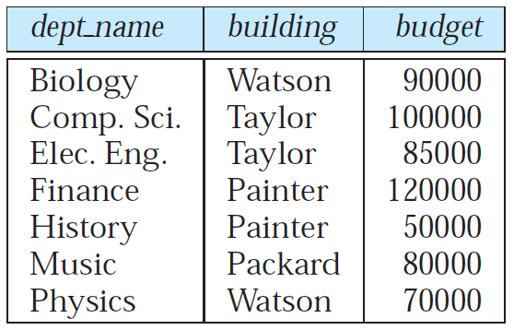
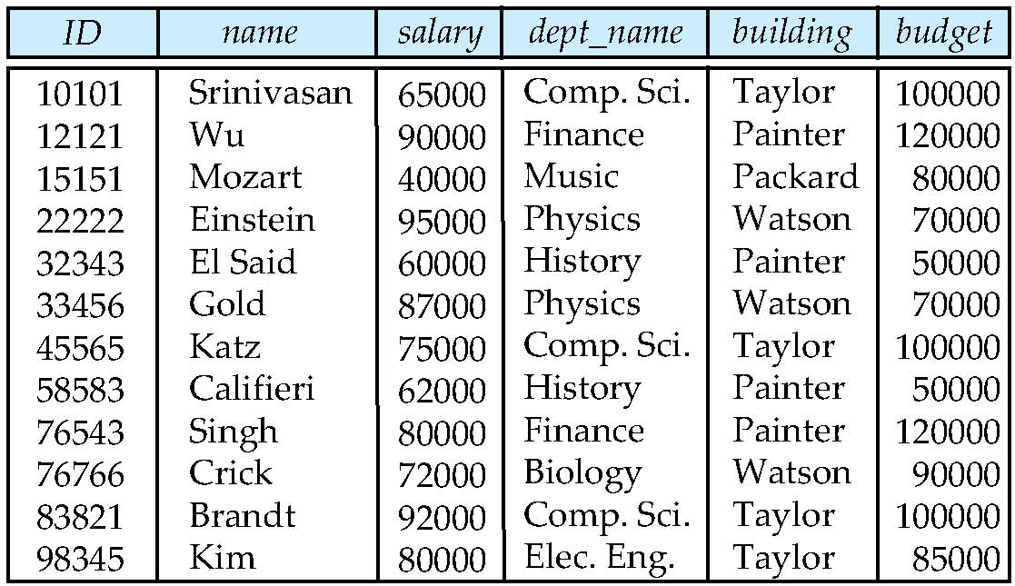
Natural Join Operation –Another Example
instructor
department

Slide 46
Composition of Operations
Can build expressions using multiple operations
Example: σ_{A=C}(r x s)
r x s
σ_{A=C}(r x s)
A
B
C
D
E
α
α
α
α
β
β
β
β
1
1
1
1
2
2
2
2
α
β
β
γ α
β
β
γ
10
10
20
10
10
10
20
10
a
a
b
b
a
a
b
b
A
B
C
D
E
α
β
β
1
2
2
α
β
β
10
10
20
a
a
b

Slide 47
Summary of Relational Algebra Operators
Symbol (Name) Example of Use
σ
(Selection) σ _{salary > = 85000} (instructor)
Return rows of the input relation that satisfy the predicate.
Π
(Projection) Π_{ID, salary} (instructor)
Output specified attributes from all rows of the input relation. Remove duplicate tuples from the output.
x
(Cartesian Product) instructor x department
Output all pairs of rows from the two input relations (regardless of whether or not they have the same values on common attributes)
∪
(Union) ^{Π} name ^{(instructor) ∪ Π} name ^{(student)}
Output the union of tuples from the two input relations.
-
(Set Difference) ^{Π} name ^{(instructor)} ^{-- Π} name ^{(student)}
Output the set difference of tuples from the two input relations.
⋈
(Natural Join) instructor ⋈ department
Output pairs of rows from the two input relations that have the same value on all attributes that have the same name.

Slide 48
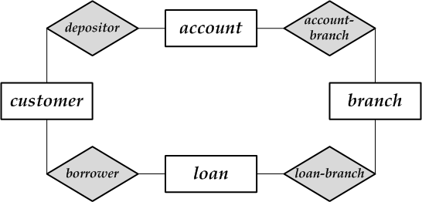
Exercise： Banking Example
E-book P54
C-book P30
Figure 2-15
branch (branch_name, branch_city, assets)
customer (customer_name, customer_street, customer_city)
account (account_number, branch_name, balance)
loan (loan_number, branch_name, amount)
depositor (customer_name, account_number)
borrower (customer_name, loan_number)

Slide 49
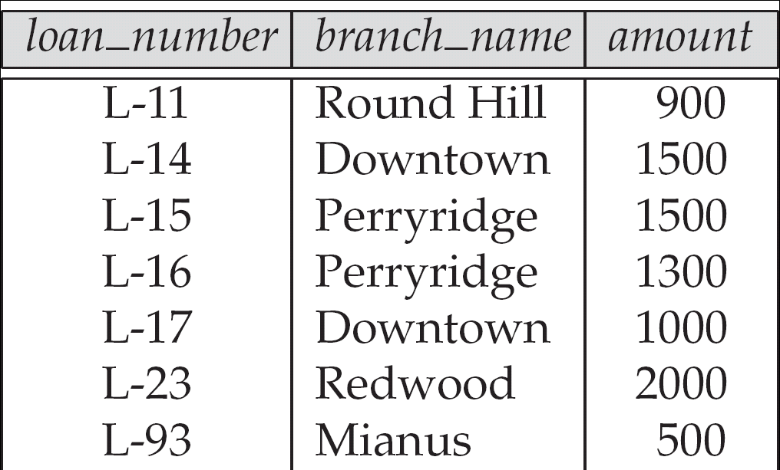
Example Queries
Find the loan number for each loan of an amount greater than $950
∏_{loan_number} (σ_{amount} _{> 950} (loan))
loan

Slide 50
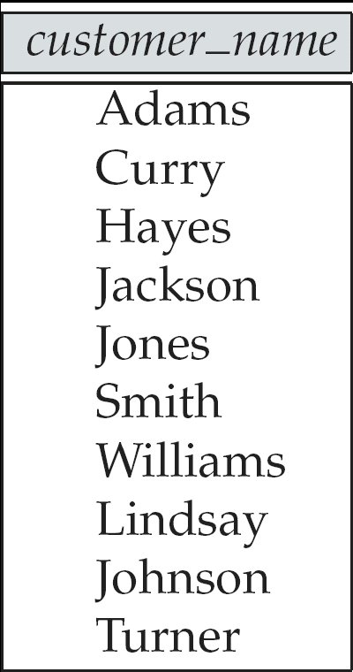
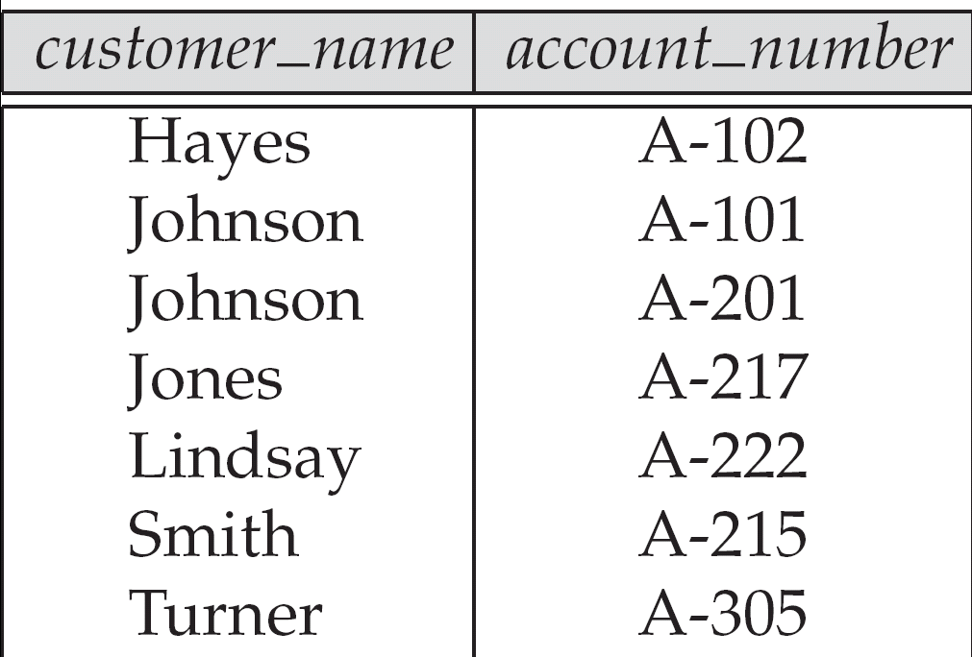
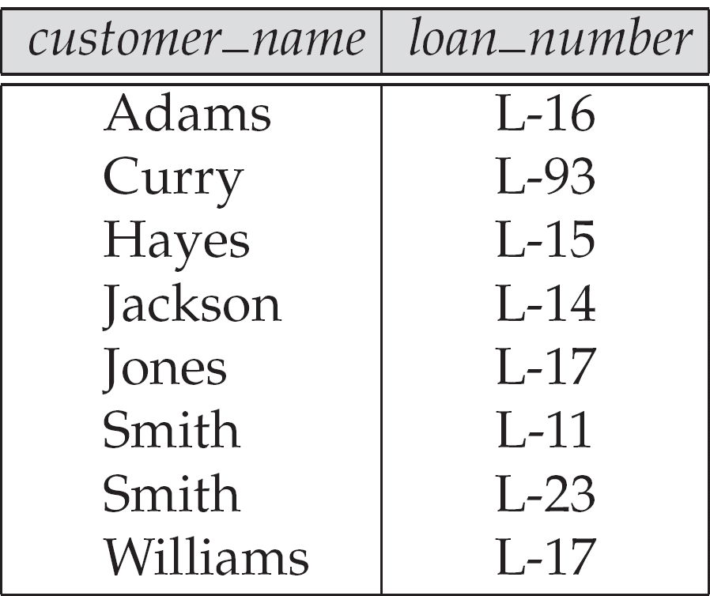
Example Queries
Find the names of all customers who have a loan, an account, or both, from the bank
∏_{customer_name} (borrower) ∪ ∏_{customer_name} (depositor)
depositor
borrower

Slide 51
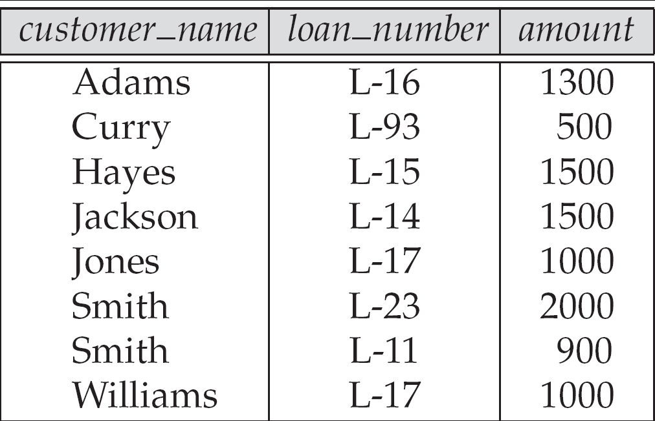
Bank Example Queries
Find the name of all customers who have a loan at the bank and their loan numbers and amount
∏customer_name, loan_number, amount (borrower loan)

Slide 52
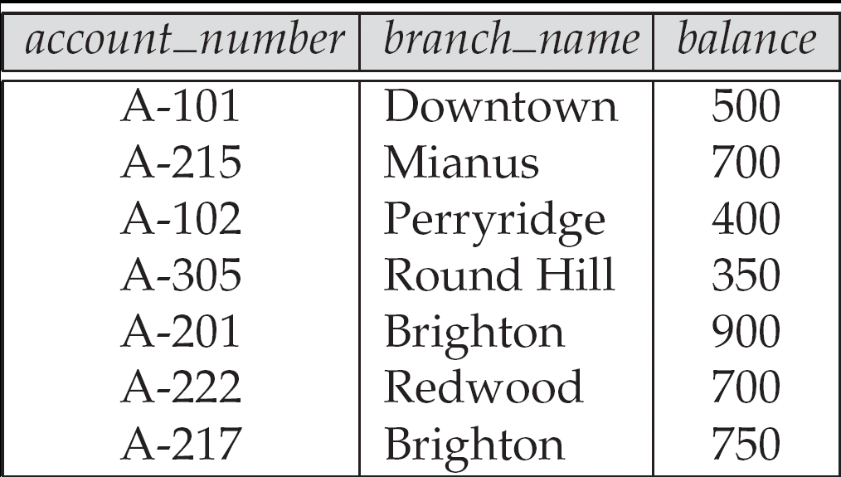
Example Queries
Find the largest account balance
account

Slide 53
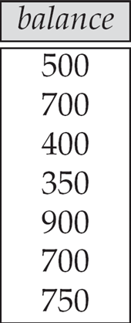
Example Queries
Strategy:
Find those balances that are not the largest
Rename account relation as d so that we can compare each account balance with all others
Use set difference to find those account balances that were not found in the earlier step.
account
d

Slide 54
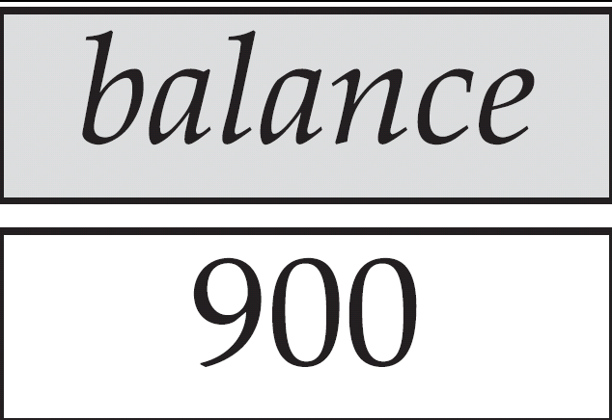
Example Queries
Find the largest account balance
The query is:
∏_{balance}(account) - ∏_{account.balance}
(σ_{account.balance < d.balance} (account x ρ_{d} (account)))

Slide 55
Assignment
2.6
2.7
2.13

Slide 56
End of Chapter 2

